Slide 1
Ingegneria dei dati Source Discovery
Paolo Merialdo

Slide 2
Programma
Introduzione: il ciclo di vita del dato
Data discovery
Searching tables in data lakes
Source discovery on the Web
Data and information extraction
Web scraping
Information extraction
Crowdsourcing
Data integration
Schema alignment
Entity resolution
Data fusion
Etica dei dati: Fairness, Explainability

Slide 3

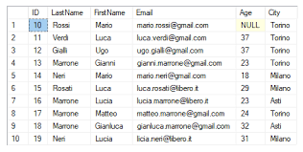

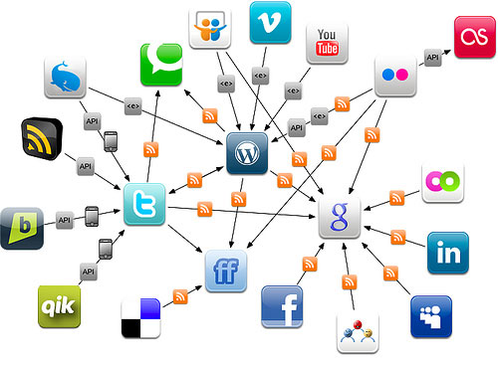
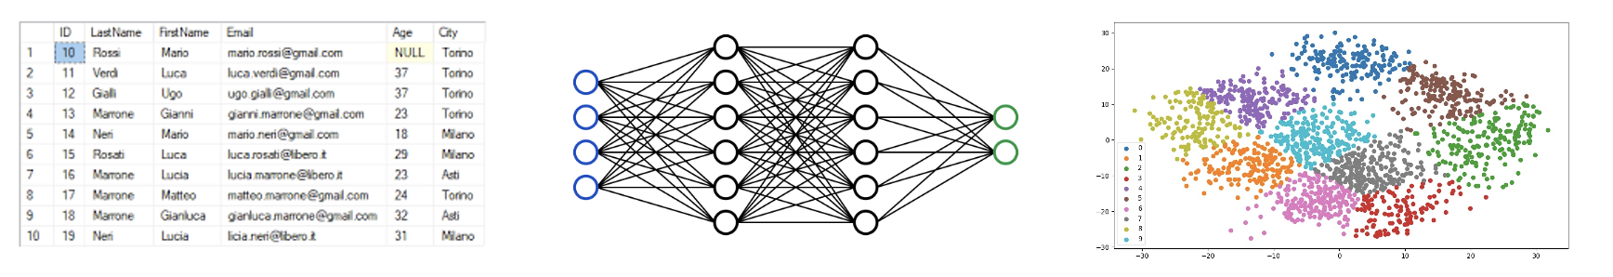
Data Preparation
Data
Engineering

Slide 4
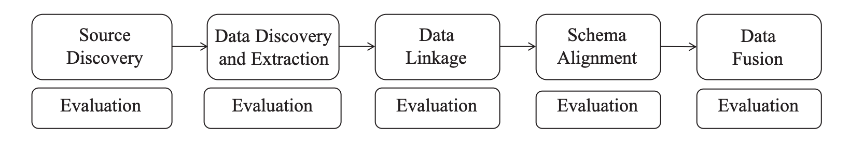
Data Engineering Pipeline
Data
Engineering

Slide 5
Outline
Background: Search technologies
Inverted index
Boolean queries
Approximate queries
Ranking
Searching tables in a data lake
Source and data discovery on the Web

Slide 6
Credits
These slides are based on the book: C. D. Manning, P. Raghavan and H. Schütze, Introduction to Information Retrieval. Cambridge University Press. 2008.

Slide 7
Key concepts
Inverted index
Dictionary & Postings
Tokens and terms
Merge algorithm
N-grams
Jaccard Coefficient
Precision, Recall, F1-Measure
Tf-idf
Cosine similarity
NOTE: there are several hidden slides. They cover interesting concepts that, though interesting, are not relevant for the purposes of this course

Slide 8
Search (once, Information retrieval)
Finding material (usually documents) of an (usually) unstructured nature (usually text) that satisfies an information need from within large collections
We frequently think first of web search, but there are many other cases:
E-mail search
Searching your laptop
Corporate knowledge bases and database
C. D. Manning, P. Raghavan and H. Schütze, Introduction to Information Retrieval

Slide 9
Basic assumptions of Information Retrieval
Collection: A set of documents
Assume it is a static collection (but can be extended to the dynamic case)
Goal: Retrieve documents with information that is relevant to the user’s information need and helps the user complete a task
C. D. Manning, P. Raghavan and H. Schütze, Introduction to Information Retrieval

Slide 10


How good are the retrieved docs?
Precision: Fraction of retrieved docs that are relevant to the user’s information need
Recall: Fraction of relevant docs in collection that are retrieved
False positives: retrieved documents that are not relevant
False negatives: relevant documents that have not been retrieved
C. D. Manning, P. Raghavan and H. Schütze, Introduction to Information Retrieval

Slide 11
Unstructured data in 1680
Which plays of Shakespeare contain the words Brutus AND Caesar but NOT Calpurnia?
One could grep all of Shakespear's plays for Brutus and Caesar, then strip out lines containing Calpurnia?
Why is that not the answer?
Slow (for large corpora)
NOT Calpurnia is non-trivial
Other operations (e.g., find the word Romans near countrymen) not feasible
Ranked retrieval (best documents to return)
C. D. Manning, P. Raghavan and H. Schütze, Introduction to Information Retrieval
Notes:
Grep is line-oriented; IR is document oriented.

Slide 12
Term-document incidence
Documents
words
Brutus AND Caesar BUT NOT Calpurnia
1 if play contains word, 0 otherwise
C. D. Manning, P. Raghavan and H. Schütze, Introduction to Information Retrieval

Slide 13
Incidence vectors
So, we have a 0/1 vector for each term.
To answer query: take the vectors for Brutus, Caesar and Calpurnia (complemented) ➔ bitwise AND.
110100 AND 110111 AND 101111 = 100100.
C. D. Manning, P. Raghavan and H. Schütze, Introduction to Information Retrieval

Slide 14
Term-document incidence
1 0 1 1 1 1
Brutus AND Caesar BUT NOT Calpurnia
1 0 0 1 0 0
1 if play contains word,
0 otherwise
C. D. Manning, P. Raghavan and H. Schütze, Introduction to Information Retrieval

Slide 15
Answers to query
Antony and Cleopatra, Act III, Scene ii
Agrippa [Aside to DOMITIUS ENOBARBUS]: Why, Enobarbus,
When Antony found Julius Caesar dead,
He cried almost to roaring; and he wept
When at Philippi he found Brutus slain.
Hamlet, Act III, Scene ii
Lord Polonius: I did enact Julius Caesar I was killed i' the
Capitol; Brutus killed me.
C. D. Manning, P. Raghavan and H. Schütze, Introduction to Information Retrieval

Slide 16
Bigger collections
Consider N = 1 million documents, each with about 1000 words
Avg 6 bytes/word including spaces/punctuation
6GB of data in the documents
Say there are M = 500K distinct terms among these
C. D. Manning, P. Raghavan and H. Schütze, Introduction to Information Retrieval

Slide 17
Can’t build the matrix
500K x 1M matrix has half-a-trillion 0’s and 1’s.
But it has no more than one billion 1’s.
matrix is extremely sparse.
What’s a better representation?
We only record the 1 positions.
Why?
C. D. Manning, P. Raghavan and H. Schütze, Introduction to Information Retrieval

Slide 18
Inverted index
For each term t, we must store a list of all documents that contain t.
Identify each by a docID, a document serial number
Can we use fixed-size arrays for this?
Brutus
1
2
4
11
31
45
173
174
Caesar
1
2
4
5
6
16
57
132
Calpurnia
2
31
54
101
What happens if the word Caesar is added to document 14?
C. D. Manning, P. Raghavan and H. Schütze, Introduction to Information Retrieval

Slide 19
Inverted index
We need variable-size postings lists
On disk, a continuous run of postings is normal and best
In memory, can use linked lists or variable length arrays
Some tradeoffs in size/ease of insertion
Posting
Brutus
1
2
4
11
31
45
173
174
Caesar
1
2
4
5
6
16
57
132
Calpurnia
2
31
54
101
Dictionary
Postings
Sorted by docID (more later on why).
C. D. Manning, P. Raghavan and H. Schütze, Introduction to Information Retrieval
Notes:
Linked lists generally preferred to arrays
Dynamic space allocation
Insertion of terms into documents easy
Space overhead of pointers

Slide 20





Inverted index construction
Sec. 1.2
Documents to
be indexed.
Friends, Romans, countrymen.
…
Tokenizer
Token stream.
Friends
Romans
Countrymen
Linguistic modules
Modified tokens.
friend
roman
countryman
Indexer
friend
2
4
roman
1
2
Inverted index.
countryman
13
16
C. D. Manning, P. Raghavan and H. Schütze, Introduction to Information Retrieval

Slide 21
Initial stages of text processing
Tokenization
Cut character sequence into word tokens
Deal with “John’s”, a state-of-the-art solution
Normalization
Map text and query term to same form
You want U.S.A. and USA to match
Stemming
We may wish different forms of a root to match
authorize, authorization
Stop words
We may omit very common words (or not)
the, a, to, of
C. D. Manning, P. Raghavan and H. Schütze, Introduction to Information Retrieval

Slide 22
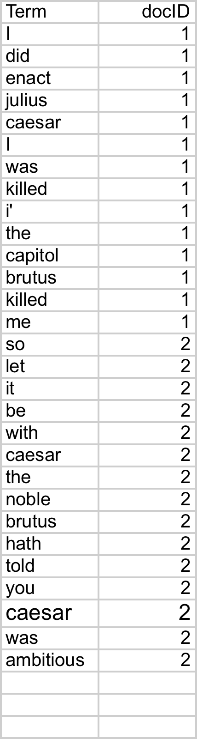
Indexer steps: Token sequence
Sec. 1.2
Sequence of (Modified token, Document ID) pairs.
Doc 1
Doc 2
I did enact Julius
Caesar I was killed
i' the Capitol;
Brutus killed me.
So let it be with
Caesar. The noble
Brutus hath told you
Caesar was ambitious
C. D. Manning, P. Raghavan and H. Schütze, Introduction to Information Retrieval

Slide 23
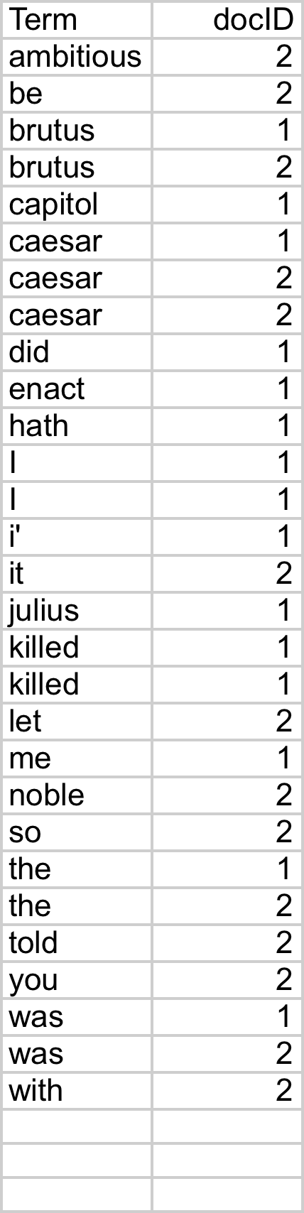
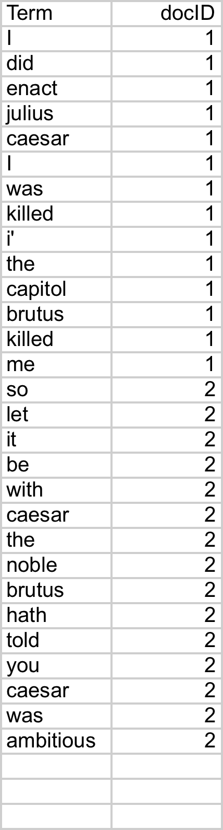
Indexer steps: Sort
Sec. 1.2
Sort by terms
And then docID
Core indexing step
C. D. Manning, P. Raghavan and H. Schütze, Introduction to Information Retrieval

Slide 24
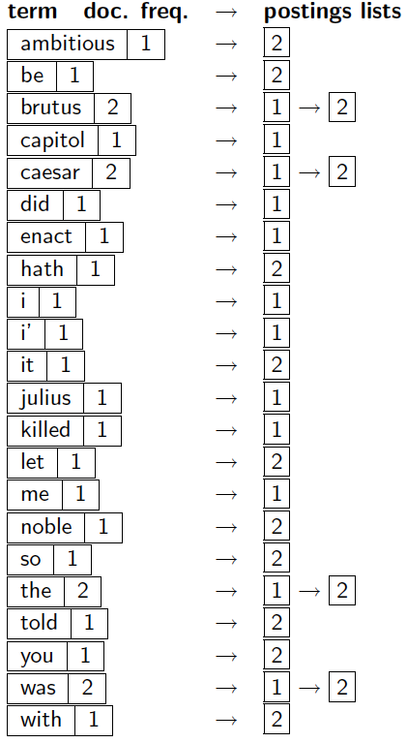
Indexer steps: Dictionary & Postings
Sec. 1.2
Multiple term entries in a single document are merged.
Split into Dictionary and Postings
Doc. frequency information is added.
Why frequency?
Will discuss later.
C. D. Manning, P. Raghavan and H. Schütze, Introduction to Information Retrieval

Slide 25
Where do we pay in storage?
Sec. 1.2
Lists of docIDs
Terms and counts
Pointers
C. D. Manning, P. Raghavan and H. Schütze, Introduction to Information Retrieval

Slide 26
The index we just built
Sec. 1.3
How do we process a query?
Later - what kinds of queries can we process?
C. D. Manning, P. Raghavan and H. Schütze, Introduction to Information Retrieval

Slide 27
Outline
Background: Search technologies
Inverted index ✓
Boolean queries
Approximate queries
Ranking
Searching tables in a data lake
Source and data discovery on the Web

Slide 28
Query processing: AND
Sec. 1.3
Consider processing the query:
Brutus AND Caesar
Locate Brutus in the Dictionary;
Retrieve its postings.
Locate Caesar in the Dictionary;
Retrieve its postings.
“Merge” the two postings:
2
4
8
16
32
64
128
Brutus
1
2
3
5
8
13
21
34
Caesar
C. D. Manning, P. Raghavan and H. Schütze, Introduction to Information Retrieval

Slide 29
The merge
Sec. 1.3
Walk through the two postings simultaneously, in time linear in the total number of postings entries
2
4
8
16
128
2
4
8
16
32
64
128
32
64
Brutus
2
8
1
2
5
8
13
21
34
Caesar
1
2
3
5
8
13
21
34
3
If the list lengths are x and y, the merge takes O(x+y)
operations.
Crucial: postings sorted by docID.
C. D. Manning, P. Raghavan and H. Schütze, Introduction to Information Retrieval

Slide 30
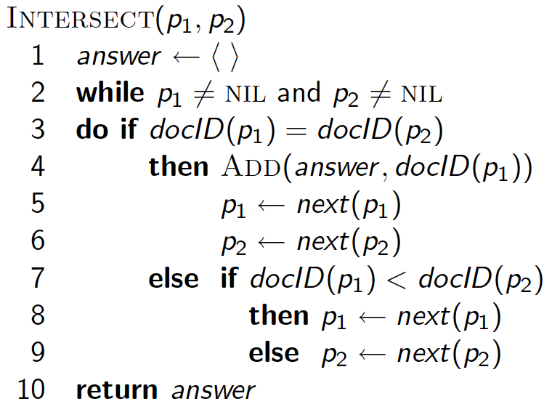
Intersecting two postings lists: merge algorithm
C. D. Manning, P. Raghavan and H. Schütze, Introduction to Information Retrieval

Slide 31
Boolean queries: Exact match
The Boolean retrieval model is being able to ask a query that is a Boolean expression:
Boolean Queries are queries using AND, OR and NOT to join query terms
Views each document as a set of words
Is precise: document matches condition or not.
Perhaps the simplest model to build an IR system on
Primary commercial retrieval tool for 3 decades.
Many search systems you still use are Boolean:
Email, library catalog, Mac OS X Spotlight
C. D. Manning, P. Raghavan and H. Schütze, Introduction to Information Retrieval

Slide 32
Boolean queries: More general merges
Sec. 1.3
Exercise: Adapt the merge for the queries:
Brutus AND NOT Caesar
Brutus OR NOT Caesar
Can we still run through the merge in time O(x+y)?
What can we achieve?
C. D. Manning, P. Raghavan and H. Schütze, Introduction to Information Retrieval

Slide 33
Merging
Sec. 1.3
What about an arbitrary Boolean formula?
(Brutus OR Caesar) AND NOT
(Antony OR Cleopatra)
Can we always merge in “linear” time?
Linear in what?
Can we do better?
C. D. Manning, P. Raghavan and H. Schütze, Introduction to Information Retrieval

Slide 34
Query optimization
What is the best order for query processing?
Consider a query that is an AND of n terms.
For each of the n terms, get its postings, then AND them together.
Brutus
2
4
8
16
32
64
128
Caesar
1
2
3
5
8
16
21
34
Calpurnia
13
16
Query: Brutus AND Calpurnia AND Caesar
C. D. Manning, P. Raghavan and H. Schütze, Introduction to Information Retrieval

Slide 35
Query optimization example
Sec. 1.3
Process in order of increasing freq:
start with smallest set, then keep cutting further.
This is why we kept
document freq. in dictionary
Brutus
2
4
8
16
32
64
128
Caesar
1
2
3
5
8
16
21
34
Calpurnia
13
16
Execute the query as (Calpurnia AND Brutus) AND Caesar.
C. D. Manning, P. Raghavan and H. Schütze, Introduction to Information Retrieval

Slide 36
More general optimization
Sec. 1.3
e.g., (madding OR crowd) AND (ignoble OR strife)
Get doc. freq.’s for all terms.
Estimate the size of each OR by the sum of its doc. freq.’s (conservative).
Process in increasing order of OR sizes.
C. D. Manning, P. Raghavan and H. Schütze, Introduction to Information Retrieval

Slide 37
Exercise
Recommend a query processing order for
(tangerine OR trees) AND
(marmalade OR skies) AND
(kaleidoscope OR eyes)
C. D. Manning, P. Raghavan and H. Schütze, Introduction to Information Retrieval

Slide 38
Query processing exercises
Exercise: If the query is friends AND romans AND (NOT countrymen), how could we use the freq of countrymen?
Exercise: Extend the merge to an arbitrary Boolean query. Can we always guarantee execution in time linear in the total postings size?
Hint: Begin with the case of a Boolean formula query: in this, each query term appears only once in the query.
C. D. Manning, P. Raghavan and H. Schütze, Introduction to Information Retrieval

Slide 39
Ranking search results
Boolean queries give inclusion or exclusion of docs.
Often, we want to rank/group results
Need to measure proximity from query to each doc.
Need to decide whether docs presented to user are singletons, or a group of docs covering various aspects of the query.
C. D. Manning, P. Raghavan and H. Schütze, Introduction to Information Retrieval

Slide 40
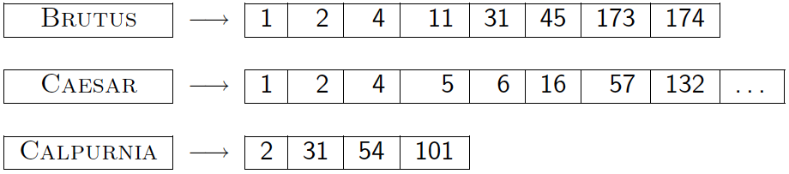
Recap so far
Basic inverted indexes:
Structure: Dictionary and Postings
Key step in construction: Sorting
Boolean query processing
Intersection by linear time “merging”
Simple optimizations
C. D. Manning, P. Raghavan and H. Schütze, Introduction to Information Retrieval

Slide 41
Plan
Elaborate basic indexing
Preprocessing to form the term vocabulary
Documents
Tokenization
What terms do we put in the index?
Postings
Faster merges: skip lists
Positional postings and phrase queries
C. D. Manning, P. Raghavan and H. Schütze, Introduction to Information Retrieval

Slide 42
Recall the basic indexing pipeline
Documents to
be indexed.
Friends, Romans, countrymen.
…
Tokenizer
Token stream.
Friends
Romans
Countrymen
Linguistic modules
Modified tokens.
friend
roman
countryman
Indexer
friend
2
4
roman
1
2
Inverted index.
countryman
13
16

Slide 43
Parsing a document
What format is it in?
pdf/word/excel/html?
What language is it in?
What character set is in use?
Each of these is a classification problem.
But these tasks are often done heuristically …
C. D. Manning, P. Raghavan and H. Schütze, Introduction to Information Retrieval

Slide 44
Complications: Format/language
Documents being indexed can include docs from many different languages
A single index may have to contain terms of several languages.
Sometimes a document or its components can contain multiple languages/formats
French email with a German pdf attachment.
What is a unit document?
A file?
An email? (Perhaps one of many in an mbox.)
An email with 5 attachments?
A group of files (PPT or LaTeX as HTML pages)
C. D. Manning, P. Raghavan and H. Schütze, Introduction to Information Retrieval
Notes:
Nontrivial issues. Requires some design decisions.

Slide 45
Tokens and Terms

Slide 46
Recall the basic indexing pipeline
Documents to
be indexed.
Friends, Romans, countrymen.
…
Tokenizer
Token stream.
Friends
Romans
Countrymen
Linguistic modules
Modified tokens.
friend
roman
countryman
Indexer
friend
2
4
roman
1
2
Inverted index.
countryman
13
16

Slide 47
Tokenization
Input: “Friends, Romans and Countrymen”
Output: Tokens
Friends
Romans
Countrymen
A token is an instance of a sequence of characters
Each such token is now a candidate for an index entry, after further processing
Described below
But what are valid tokens to emit?
C. D. Manning, P. Raghavan and H. Schütze, Introduction to Information Retrieval

Slide 48
Tokenization
Issues in tokenization:
Finland’s capital →
Finland? Finlands? Finland’s?
Hewlett-Packard → Hewlett and Packard as two tokens?
state-of-the-art: break up hyphenated sequence.
co-education
lowercase, lower-case, lower case ?
It can be effective to get the user to put in possible hyphens
San Francisco: one token or two?
How do you decide it is one token?
C. D. Manning, P. Raghavan and H. Schütze, Introduction to Information Retrieval

Slide 49
Numbers
3/20/91 Mar. 12, 1991 20/3/91
55 B.C.
B-52
My PGP key is 324a3df234cb23e
(800) 234-2333
Often have embedded spaces
Older IR systems may not index numbers
But often very useful: think about things like looking up error codes/stacktraces on the web
(One answer is using n-grams: Lecture 3)
Will often index “meta-data” separately
Creation date, format, etc.
C. D. Manning, P. Raghavan and H. Schütze, Introduction to Information Retrieval

Slide 50
Tokenization: language issues
French
L'ensemble → one token or two?
L ? L’ ? Le ?
Want l’ensemble to match with un ensemble
Until at least 2003, it didn’t on Google
Internationalization!
German noun compounds are not segmented
Lebensversicherungsgesellschaftsangestellter
‘life insurance company employee’
German retrieval systems benefit greatly from a compound splitter module
Can give a 15% performance boost for German
C. D. Manning, P. Raghavan and H. Schütze, Introduction to Information Retrieval

Slide 51
Tokenization: language issues
Chinese and Japanese have no spaces between words:
莎拉波娃现在居住在美国东南部的佛罗里达。
Not always guaranteed a unique tokenization
Further complicated in Japanese, with multiple alphabets intermingled
Dates/amounts in multiple formats
フォーチュン500社は情報不足のため時間あた$500K(約6,000万円)
Katakana
Hiragana
Kanji
Romaji
End-user can express query entirely in hiragana!
C. D. Manning, P. Raghavan and H. Schütze, Introduction to Information Retrieval

Slide 52
Tokenization: language issues
Arabic (or Hebrew) is basically written right to left, but with certain items like numbers written left to right
Words are separated, but letter forms within a word form complex ligatures
← → ← → ← start
‘Algeria achieved its independence in 1962 after 132 years of French occupation.’
With Unicode, the surface presentation is complex, but the stored form is straightforward
C. D. Manning, P. Raghavan and H. Schütze, Introduction to Information Retrieval

Slide 53
Tokenization
The same exact tokenization process must be performed on both the documents and the queries
C. D. Manning, P. Raghavan and H. Schütze, Introduction to Information Retrieval

Slide 54
Stop words
With a stop list, you exclude from the dictionary entirely the commonest words. Intuition:
They have little semantic content: the, a, and, to, be
There are a lot of them: ~30% of postings for top 30 words
But the trend is away from doing this:
Good compression techniques (chapter 5) means the space for including stop words in a system is very small
Good query optimization techniques (chapter 7) mean you pay little at query time for including stop words.
You need them for:
Phrase queries: “King of Denmark”
Various song titles, etc.: “Let it be”, “To be or not to be”
“Relational” queries: “flights to London”
C. D. Manning, P. Raghavan and H. Schütze, Introduction to Information Retrieval
Notes:
Nevertheless: “Google ignores common words and characters such as where, the, how, and other digits and letters which slow down your search without improving the results.” (Though you can explicitly ask for them to remain.)

Slide 55
Normalization to terms: equivalence classes
We need to “normalize” words in indexed text as well as query words into the same form
We want to match U.S.A. and USA
Result is terms: a term is a (normalized) word type, which is an entry in our IR system dictionary
We most commonly implicitly define equivalence classes of terms by, e.g.,
deleting periods to form a term
U.S.A., USA ⎝ USA
deleting hyphens to form a term
anti-discriminatory, antidiscriminatory ⎝ antidiscriminatory
C. D. Manning, P. Raghavan and H. Schütze, Introduction to Information Retrieval

Slide 56
Normalization: other languages
Accents: e.g., French résumé vs. resume.
Umlauts: e.g., German: Tuebingen vs. Tübingen
Should be equivalent
Most important criterion:
How are your users like to write their queries for these words?
Even in languages that standardly have accents, users often may not type them
Often best to normalize to a de-accented term
Tuebingen, Tübingen, Tubingen ⎝ Tubingen
C. D. Manning, P. Raghavan and H. Schütze, Introduction to Information Retrieval

Slide 57
Normalization: other languages
Normalization of things like date forms
7月30日 vs. 7/30
Japanese use of kana vs. Chinese characters
Tokenization and normalization may depend on the language and so is intertwined with language detection
Crucial: Need to “normalize” indexed text as well as query terms into the same form
Is this
German “mit”?
Morgen will ich in MIT …
C. D. Manning, P. Raghavan and H. Schütze, Introduction to Information Retrieval

Slide 58
Case folding
Reduce all letters to lower case
exception: upper case in mid-sentence?
e.g., General Motors
Fed vs. fed
SAIL vs. sail
Often best to lower case everything, since users will use lowercase regardless of ‘correct’ capitalization…
Google example (not valid anymore):
Query C.A.T.
#1 result was for “cat” (well, Lolcats) not Caterpillar Inc.
Another interesting Google examples:
query aapl
query jordan
query jaguar
C. D. Manning, P. Raghavan and H. Schütze, Introduction to Information Retrieval

Slide 59
Normalization to terms
Sec. 2.2.3
An alternative to equivalence classing is to do asymmetric expansion
An example of where this may be useful
Enter: window Search: window, windows
Enter: windows Search: Windows, windows, window
Enter: Windows Search: Windows
Potentially more powerful, but less efficient
C. D. Manning, P. Raghavan and H. Schütze, Introduction to Information Retrieval
Notes:
Why not the reverse?

Slide 60
Thesauri and soundex
Do we handle synonyms and homonyms?
E.g., by hand-constructed equivalence classes
car = automobile color = colour
We can rewrite to form equivalence-class terms
When the document contains automobile, index it under car-automobile (and vice-versa)
Or we can expand a query
When the query contains automobile, look under car as well
What about spelling mistakes?
One approach is soundex, which forms equivalence classes of words based on phonetic heuristics
More later
C. D. Manning, P. Raghavan and H. Schütze, Introduction to Information Retrieval

Slide 61
Lemmatization
Reduce inflectional/variant forms to base form
E.g.,
am, are, is → be
car, cars, car's, cars' → car
the boy's cars are different colors → the boy car be different color
Lemmatization implies doing “proper” reduction to dictionary headword form
C. D. Manning, P. Raghavan and H. Schütze, Introduction to Information Retrieval

Slide 62
Stemming
Reduce terms to their “roots” before indexing
“Stemming” suggest crude affix chopping
language dependent
e.g., automate(s), automatic, automation all reduced to automat.
for example compressed
and compression are both
accepted as equivalent to
compress.
for exampl compress and
compress ar both accept
as equival to compress
C. D. Manning, P. Raghavan and H. Schütze, Introduction to Information Retrieval

Slide 63
Porter’s algorithm
Commonest algorithm for stemming English
Results suggest it’s at least as good as other stemming options
Conventions + 5 phases of reductions
phases applied sequentially
each phase consists of a set of commands
sample convention: Of the rules in a compound command, select the one that applies to the longest suffix.
C. D. Manning, P. Raghavan and H. Schütze, Introduction to Information Retrieval

Slide 64
Typical rules in Porter
sses → ss
ies → i
ational → ate
tional → tion
Weight of word sensitive rules
(m>1) EMENT →
replacement → replac
cement → cement
C. D. Manning, P. Raghavan and H. Schütze, Introduction to Information Retrieval

Slide 65
Other stemmers
Other stemmers exist, e.g., Lovins stemmer
http://www.comp.lancs.ac.uk/computing/research/stemming/general/lovins.htm
Single-pass, longest suffix removal (about 250 rules)
Full morphological analysis – at most modest benefits for retrieval
Do stemming and other normalizations help?
English: very mixed results. Helps recall for some queries but harms precision on others
E.g., operative (dentistry) ⇒ oper
Definitely useful for Spanish, German, Finnish, …
30% performance gains for Finnish!
C. D. Manning, P. Raghavan and H. Schütze, Introduction to Information Retrieval

Slide 66
Language-specificity
Many of the above features embody transformations that are
Language-specific and
Often, application-specific
These are “plug-in” addenda to the indexing process
Both open source and commercial plug-ins are available for handling these
C. D. Manning, P. Raghavan and H. Schütze, Introduction to Information Retrieval

Slide 67
Dictionary entries – first cut
ensemble.french
時間.japanese
MIT.english
mit.german
guaranteed.english
entries.english
sometimes.english
tokenization.english
These may be grouped by language (or not…).
More on this in ranking/query processing.
C. D. Manning, P. Raghavan and H. Schütze, Introduction to Information Retrieval

Slide 68
Faster postings merges: Skip pointers/Skip lists

Slide 69
Recall basic merge
Sec. 2.3
Walk through the two postings simultaneously, in time linear in the total number of postings entries
2
4
8
41
48
64
128
Brutus
2
8
1
2
3
8
11
17
21
31
Caesar
If the list lengths are m and n, the merge takes O(m+n)
operations.
Can we do better?
Yes (if index isn’t changing too fast).
C. D. Manning, P. Raghavan and H. Schütze, Introduction to Information Retrieval

Slide 70
Augment postings with skip pointers (at indexing time)
41
128
2
4
8
41
48
64
128
11
31
1
2
3
8
11
17
21
31
Why?
To skip postings that will not figure in the search results.
How?
Where do we place skip pointers?
C. D. Manning, P. Raghavan and H. Schütze, Introduction to Information Retrieval

Slide 71
Query processing with skip pointers
41
128
2
4
8
41
48
64
128
11
31
1
2
3
8
11
17
21
31
Suppose we’ve stepped through the lists until we process 8 on each list. We match it and advance.
We then have 41 and 11 on the lower. 11 is smaller.
But the skip successor of 11 on the lower list is 31, so
we can skip ahead past the intervening postings.
C. D. Manning, P. Raghavan and H. Schütze, Introduction to Information Retrieval

Slide 72
Where do we place skips?
Tradeoff:
More skips → shorter skip spans ⇒ more likely to skip. But lots of comparisons to skip pointers.
Fewer skips → few pointer comparison, but then long skip spans ⇒ few successful skips.
C. D. Manning, P. Raghavan and H. Schütze, Introduction to Information Retrieval

Slide 73
Placing skips
Simple heuristic: for postings of length L, use √L evenly-spaced skip pointers.
Easy if the index is relatively static; harder if L keeps changing because of updates.
This definitely used to help; with modern hardware it may not (Bahle et al. 2002) unless you’re memory-based
The I/O cost of loading a bigger postings list can outweigh the gains from quicker in memory merging!
C. D. Manning, P. Raghavan and H. Schütze, Introduction to Information Retrieval

Slide 74
Outline
Background: Search technologies
Inverted index ✓
Boolean queries ✓
Approximate queries
Ranking
Searching tables in a data lake
Source and data discovery on the Web

Slide 75
Phrase queries and positional indexes

Slide 76
Phrase queries
Want to be able to answer queries such as “Roma Tre” – as a phrase
Thus, the sentence "a Roma ho preso tre autobus" is not a match.
The concept of phrase queries has proven easily understood by users; one of the few “advanced search” ideas that works
Many more queries are implicit phrase queries
For this, it no longer suffices to store only
<term : docs> entries
C. D. Manning, P. Raghavan and H. Schütze, Introduction to Information Retrieval

Slide 77
A first attempt: Biword indexes
Index every consecutive pair of terms in the text as a phrase
For example, the text “Friends, Romans, Countrymen” would generate the biwords
friends romans
romans countrymen
Each of these biwords is now a dictionary term
Two-word phrase query-processing is now immediate.
C. D. Manning, P. Raghavan and H. Schütze, Introduction to Information Retrieval

Slide 78
Longer phrase queries
Longer phrases are processed as we did with wild-cards:
"Università degli Studi Roma Tre" can be broken into the Boolean query on biwords:
Università degli AND degli Studi AND Studi Roma AND Roma Tre
Without the docs, we cannot verify that the docs matching the above Boolean query do contain the phrase.
Can have false positives!
C. D. Manning, P. Raghavan and H. Schütze, Introduction to Information Retrieval

Slide 79
Extended biwords
Parse the indexed text and perform part-of-speech-tagging (POST).
Bucket the terms into (say) Nouns (N) and articles/prepositions (X).
Call any string of terms of the form NX*N an extended biword.
Each such extended biword is now made a term in the dictionary.
Example: catcher in the rye
N X X N
Query processing: parse it into N’s and X’s
Segment query into enhanced biwords
Look up in index: catcher rye
C. D. Manning, P. Raghavan and H. Schütze, Introduction to Information Retrieval

Slide 80
Issues for biword indexes
False positives, as noted before
Index blowup due to bigger dictionary
Infeasible for more than biwords, big even for them
Biword indexes are not the standard solution (for all biwords) but can be part of a compound strategy
C. D. Manning, P. Raghavan and H. Schütze, Introduction to Information Retrieval

Slide 81
Solution 2: Positional indexes
In the postings, store, for each term the position(s) in which tokens of it appear:
<term, number of docs containing term;
doc1: position1, position2 … ;
doc2: position1, position2 … ;
etc.>
C. D. Manning, P. Raghavan and H. Schütze, Introduction to Information Retrieval

Slide 82
Positional index example
<be: 993427;
1: 7, 18, 33, 72, 86, 231;
2: 3, 149;
4: 17, 191, 291, 430, 434;
5: 363, 367, …>
Which of docs 1,2,4,5
could contain “to be
or not to be”?
For phrase queries, we use a merge algorithm recursively at the document level
But we now need to deal with more than just equality
C. D. Manning, P. Raghavan and H. Schütze, Introduction to Information Retrieval

Slide 83
Processing a phrase query
Extract inverted index entries for each distinct term: to, be, or, not.
Merge their doc:position lists to enumerate all positions with “to be or not to be”.
to:
2:1,17,74,222,551; 4:8,16,190,429,433; 7:13,23,191; ...
be:
1:17,19; 4:17,191,291,430,434; 5:14,19,101; ...
Same general method for proximity searches
C. D. Manning, P. Raghavan and H. Schütze, Introduction to Information Retrieval

Slide 84
Positional index size
You can compress position values/offsets
Nevertheless, a positional index expands postings storage substantially
Nevertheless, a positional index is now standardly used because of the power and usefulness of phrase and proximity queries … whether used explicitly or implicitly in a ranking retrieval system.
C. D. Manning, P. Raghavan and H. Schütze, Introduction to Information Retrieval

Slide 85
Positional index size
Need an entry for each occurrence, not just once per document
Index size depends on average document size
Average web page has <1000 terms
SEC filings, books, even some epic poems … easily 100,000 terms
Consider a term with frequency 0.1%
Why?
Document size
Postings
Positional postings
1000
1
1
100,000
1
100
C. D. Manning, P. Raghavan and H. Schütze, Introduction to Information Retrieval

Slide 86
Rules of thumb
A positional index is 2–4 as large as a non-positional index
Positional index size 35–50% of volume of original text
Caveat: all of this holds for “English-like” languages
C. D. Manning, P. Raghavan and H. Schütze, Introduction to Information Retrieval

Slide 87
Combination schemes
These two approaches can be profitably combined
For particular phrases (“Michael Jackson”, “Britney Spears”) it is inefficient to keep on merging positional postings lists
Even more so for phrases like “The Who”
Williams et al. (2004) evaluate a more sophisticated mixed indexing scheme
A typical web query mixture was executed in ¼ of the time of using just a positional index
It required 26% more space than having a positional index alone
C. D. Manning, P. Raghavan and H. Schütze, Introduction to Information Retrieval

Slide 88
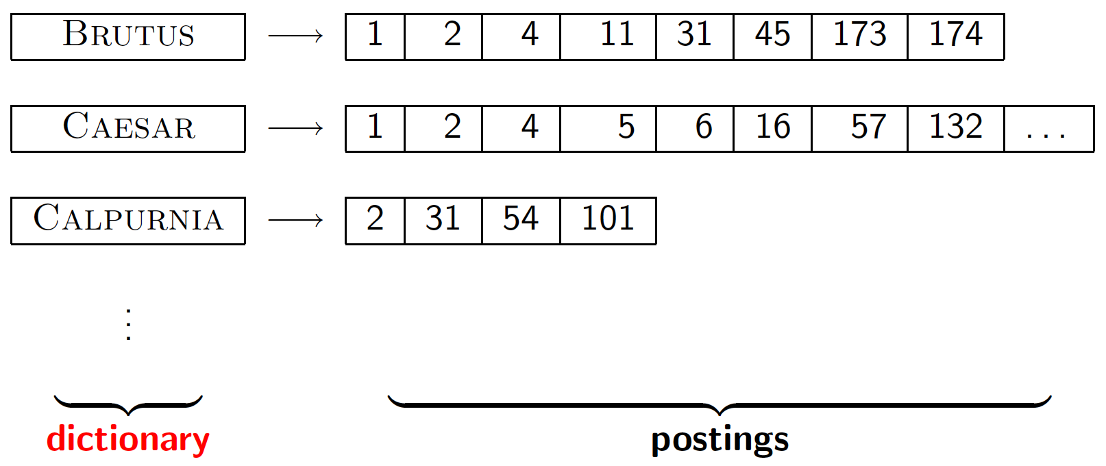
Dictionary data structures for inverted indexes
The dictionary data structure stores the term vocabulary, document frequency, pointers to each postings list … in what data structure?
C. D. Manning, P. Raghavan and H. Schütze, Introduction to Information Retrieval

Slide 89
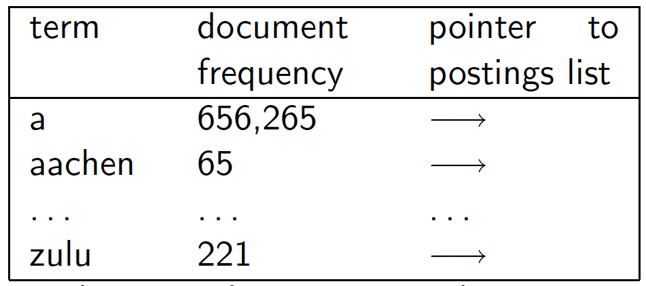
A naïve dictionary
An array of struct:
char[20] int Postings *
20 bytes 4/8 bytes 4/8 bytes
How do we store a dictionary in memory efficiently?
How do we quickly look up elements at query time?
C. D. Manning, P. Raghavan and H. Schütze, Introduction to Information Retrieval

Slide 90
Dictionary data structures
Two main choices:
Hashtables
Trees
Some IR systems use hashtables, some trees
C. D. Manning, P. Raghavan and H. Schütze, Introduction to Information Retrieval

Slide 91
Hashtables
Each vocabulary term is hashed to an integer
Pros:
Lookup is faster than for a tree: O(1)
Cons:
No easy way to find minor variants:
judgment/judgement
No prefix search (e.g., entrep*) [tolerant retrieval]
If vocabulary keeps growing, need to occasionally do the expensive operation of rehashing everything
C. D. Manning, P. Raghavan and H. Schütze, Introduction to Information Retrieval

Slide 92
Tree: binary tree
Root
a-m
n-z
a-hu
hy-m
n-sh
si-z
huygens
sickle
zygot
aardvark

Slide 93
Trees
Sec. 3.1
Simplest: binary tree
More usual: B-trees
Trees require a standard ordering of characters and hence strings … but we typically have one
Pros:
Solves the prefix problem (terms starting with entrep)
Cons:
Slower: O(log M) [and this requires balanced tree]
Rebalancing binary trees is expensive
But B-trees mitigate the rebalancing problem
C. D. Manning, P. Raghavan and H. Schütze, Introduction to Information Retrieval

Slide 94
Tree: B-tree
Sec. 3.1
a-hu
n-z
hy-m
Definition: Every internal node has a number of children in the interval [a,b] where a, b are appropriate natural numbers, e.g., [2,4].
C. D. Manning, P. Raghavan and H. Schütze, Introduction to Information Retrieval

Slide 95
Wild-card queries
C. D. Manning, P. Raghavan and H. Schütze, Introduction to Information Retrieval

Slide 96
Wild-card queries: *
Sec. 3.2
mon*: find all docs containing any word beginning with "mon".
Easy with binary tree (or B-tree) lexicon: retrieve all words w such that mon ≤ w < moo
*mon: find words ending in "mon": harder
Maintain an additional B-tree for terms backwards.
Can retrieve all words in range: nom ≤ w < non.
Exercise: from this, how can we enumerate all terms
meeting the wild-card query pro*cent ?
C. D. Manning, P. Raghavan and H. Schütze, Introduction to Information Retrieval

Slide 97
Query processing
Sec. 3.2
At this point, we have an enumeration of all terms in the dictionary that match the wild-card query.
We still have to look up the postings for each enumerated term.
E.g., consider the query:
se*ate AND fil*er
This may result in the execution of many Boolean AND queries.
C. D. Manning, P. Raghavan and H. Schütze, Introduction to Information Retrieval

Slide 98
B-trees handle *'s at the end of a query term
Sec. 3.2
How can we handle *'s in the middle of query term?
co*tion
We could look up co* AND *tion in a B-tree and intersect the two term sets
Expensive
The solution: transform wild-card queries so that the *'s occur at the end
This gives rise to the Permuterm Index.
C. D. Manning, P. Raghavan and H. Schütze, Introduction to Information Retrieval

Slide 99
Wild-card queries: PERMUTERM INDEX
C. D. Manning, P. Raghavan and H. Schütze, Introduction to Information Retrieval

Slide 100
Permuterm index
First, we introduce a special symbol ($) into our character set to mark the end of a term
hello → hello$
Next, we construct a "permuterm" index:
the various rotations of each term (augmented with $) all link to the original vocabulary term
C. D. Manning, P. Raghavan and H. Schütze, Introduction to Information Retrieval

Slide 101
Permuterm index
hello$
ello$h
hello
llo$he
…
o$hell
homo$
omo$h
homo
mo$ho
…
Dictionary
Postings
o$homo
Permuterm
vocabulary
C. D. Manning, P. Raghavan and H. Schütze, Introduction to Information Retrieval

Slide 102
Permuterm index
How does this index help us with wildcard queries?
Consider the wildcard query h*o
The key is to rotate such a wildcard query so that the * symbol appears at the end of the string
The rotated wildcard query becomes o$h*
Next, we look up this string in the permuterm index, where seeking o$h* (via a search tree) leads to rotations of (among others) the terms hello and homo

Slide 103
Permuterm index
Sec. 3.2.1
For term hello, index under:
hello$, ello$h, llo$he, lo$hel, o$hell
where $ is a special symbol.
Queries:
X lookup on X$ X* lookup on $X*
*X lookup on X$* *X* lookup on X*
X*Y lookup on Y$X*
Query = hel*o
X=hel, Y=o
Lookup o$hel*
C. D. Manning, P. Raghavan and H. Schütze, Introduction to Information Retrieval

Slide 104
Permuterm index
X*Y*Z ???
Z$X*
But not all such dictionary terms will have the string Y in the middle
Then, we have filter these out by exhaustive enumeration, checking each candidate to see if it contains Y
C. D. Manning, P. Raghavan and H. Schütze, Introduction to Information Retrieval

Slide 105
Permuterm query processing
Rotate query wild-card to the right
Now use B-tree lookup as before.
Permuterm problem: ≈ quadruples lexicon size
Empirical observation for English.
C. D. Manning, P. Raghavan and H. Schütze, Introduction to Information Retrieval

Slide 106
Wild-card queries: N-GRAMS
C. D. Manning, P. Raghavan and H. Schütze, Introduction to Information Retrieval

Slide 107
Wild-card queries: *
Sec. 3.2
mon*: find all docs containing any word beginning with "mon".
Easy with binary tree (or B-tree) lexicon: retrieve all words w such that mon ≤ w < moo
*mon: find words ending in "mon": harder
Maintain an additional B-tree for terms backwards.
Can retrieve all words in range: nom ≤ w < non.
C. D. Manning, P. Raghavan and H. Schütze, Introduction to Information Retrieval

Slide 108
Bigram (k-gram) indexes
Enumerate all k-grams (sequence of k chars) occurring in any term
e.g., from text "April is the cruelest month" we get the 2-grams (bigrams)
$ is a special word boundary symbol
Maintain a second inverted index from bigrams to dictionary terms that match each bigram.
$a,ap,pr,ri,il,l$,$i,is,s$,$t,th,he,e$,$c,cr,ru,
ue,el,le,es,st,t$, $m,mo,on,nt,h$
C. D. Manning, P. Raghavan and H. Schütze, Introduction to Information Retrieval

Slide 109
Bigram index example
The k-gram index finds terms based on a query consisting of k-grams (here k=2).
$m
mace
madden
mo
among
amortize
on
along
among
C. D. Manning, P. Raghavan and H. Schütze, Introduction to Information Retrieval

Slide 110
Processing wild-cards
Query like mon* can now be run as
$m AND mo AND on
Gets terms that match AND version of our wildcard query.
But we’d enumerate moon.
Must post-filter these terms against query.
Surviving enumerated terms are then looked up in the term-document inverted index.
Fast, space efficient.
C. D. Manning, P. Raghavan and H. Schütze, Introduction to Information Retrieval

Slide 111
Spelling correction

Slide 112
Spell correction
Two principal uses
Correcting document(s) being indexed
Correcting user queries to retrieve "right" answers
Two main flavors:
Isolated word
Check each word on its own for misspelling
Will not catch typos resulting in correctly spelled words
e.g., from → form
Context-sensitive
Look at surrounding words,
e.g., I flew form Heathrow to Narita.
C. D. Manning, P. Raghavan and H. Schütze, Introduction to Information Retrieval

Slide 113
Document correction
Especially needed for OCR'ed documents
Correction algorithms are tuned for this: rn/m
Can use domain-specific knowledge
E.g., OCR can confuse O and D more often than it would confuse O and I (adjacent on the QWERTY keyboard, so more likely interchanged in typing).
But also: web pages and even printed material have typos
Goal: the dictionary contains fewer misspellings
But often we don't change the documents and instead fix the query-document mapping
C. D. Manning, P. Raghavan and H. Schütze, Introduction to Information Retrieval

Slide 114
Query mis-spellings
Our principal focus here
E.g., the query famos enterprenuers
We can either
Retrieve documents indexed by the correct spelling
Showing results for famous entrepreneurs
Or return several suggested alternative queries with the correct spelling
Did you mean famous entrepreneurs?
C. D. Manning, P. Raghavan and H. Schütze, Introduction to Information Retrieval

Slide 115
Isolated word correction
Fundamental premise: there is a lexicon from which the correct spellings come
Two basic choices for this
A standard lexicon such as
Webster's English Dictionary
An "industry-specific" lexicon – hand-maintained
The lexicon of the indexed corpus
E.g., all words on the web
All names, acronyms etc.
(Including the mis-spellings)
C. D. Manning, P. Raghavan and H. Schütze, Introduction to Information Retrieval

Slide 116
Isolated word correction
Given a lexicon and a character sequence Q, return the words in the lexicon closest to Q
What’s "closest"?
Several alternatives
Edit distance (Levenshtein distance)
Weighted edit distance
n-gram overlap
C. D. Manning, P. Raghavan and H. Schütze, Introduction to Information Retrieval

Slide 117
Edit distance (Levenshtein distance)
Given two strings S₁ and S₂, the minimum number of operations to convert one to the other
Operations are typically character-level
Insert, Delete, Replace, (Transposition)
E.g., the edit distance from dof to dog is 1
From cat to act is 2 (Just 1 with transpose.)
from cat to dog is 3.
Generally found by dynamic programming.
C. D. Manning, P. Raghavan and H. Schütze, Introduction to Information Retrieval

Slide 118
Weighted edit distance
As above, but the weight of an operation depends on the character(s) involved
Meant to capture OCR or keyboard errors Example: m more likely to be mis-typed as n than as q
Therefore, replacing m by n is a smaller edit distance than by q
This may be formulated as a probability model
Requires weight matrix as input
Modify dynamic programming to handle weights
C. D. Manning, P. Raghavan and H. Schütze, Introduction to Information Retrieval

Slide 119
Using edit distances
Given query,
first enumerate all character sequences within a preset (weighted) edit distance (e.g., 2)
Intersect this set with list of "correct" words
Show terms you found to user as suggestions
Alternatively to 3,
We can look up all possible corrections in our inverted index and return all docs … slow
We can run with a single most likely correction (Google's "Showing results for …")
The alternatives disempower the user, but save a round of interaction with the user
C. D. Manning, P. Raghavan and H. Schütze, Introduction to Information Retrieval

Slide 120
Edit distance to all dictionary terms?
Given a (mis-spelled) query – do we compute its edit distance to every dictionary term?
Expensive and slow
Alternative?
How do we cut the set of candidate dictionary terms?
One possibility is to use n-gram overlap for this
This can also be used by itself for spelling correction
C. D. Manning, P. Raghavan and H. Schütze, Introduction to Information Retrieval
Notes:
Alternative is to generate everything up to edit distance k and then intersect. Fine for distance 1; okay for distance 2. This is generally enough (Norvig).

Slide 121
n-gram overlap
Enumerate all the n-grams in the query string as well as in the lexicon
Use the n-gram index (recall wild-card search) to retrieve all lexicon terms matching any of the query n-grams
Threshold by number of matching n-grams
Variants – weight by keyboard layout, etc.
C. D. Manning, P. Raghavan and H. Schütze, Introduction to Information Retrieval

Slide 122
Example
Query: bord → bo AND or AND rd
bo
aboard
about
boardroom
border
or
border
lord
morbid
sordid
rd
aboard
ardent
boardroom
border
C. D. Manning, P. Raghavan and H. Schütze, Introduction to Information Retrieval

Slide 123
Example
Query: bord → bo AND or AND rd
Enumetate all terms containting at least 2 bigrams
bo
aboard
about
boardroom
border
or
border
lord
morbid
sordid
rd
aboard
ardent
boardroom
border

Slide 124
Example
Query: bord → bo AND or AND rd
Enumetate all terms containting at least 2 bigrams
boardroom is an implausible correction
bo
aboard
about
boardroom
border
or
border
cortine
morbid
sordid
rd
aboard
ardent
boardroom
border

Slide 125
Example with trigrams
Suppose the text is november
Trigrams are nov, ove, vem, emb, mbe, ber.
The query is december
Trigrams are dec, ece, cem, emb, mbe, ber.
So, 3 trigrams overlap (of 6 in each term)
How can we turn this into a normalized measure of overlap?
C. D. Manning, P. Raghavan and H. Schütze, Introduction to Information Retrieval

Slide 126
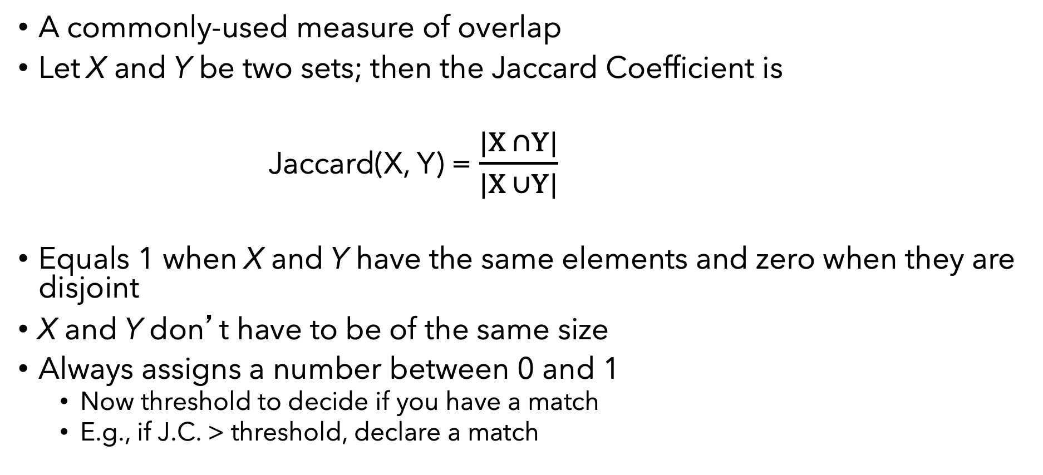
One option – Jaccard coefficient
A commonly-used measure of overlap
Let X and Y be two sets; then the Jaccard Coefficient is
Jaccard(X, Y) = $\frac{|X ∩Y|}{|X ∪Y|}$
Equals 1 when X and Y have the same elements and zero when they are disjoint
X and Y don’t have to be of the same size
Always assigns a number between 0 and 1
Now threshold to decide if you have a match
E.g., if J.C. > threshold, declare a match
C. D. Manning, P. Raghavan and H. Schütze, Introduction to Information Retrieval

Slide 127
Jaccard: Example
bord → bo – or – rd
border → bo – or – rd – de – er
abord → ab – bo – or – rd
boardroom → bo – oa – ar – rd – dr – ro – oo – om
J(bord, border) = 3/5 = 0.6
J(bord, abord) = 3/4 = 0.75
J(bord, boardroom)= 2/9 = 0.22
C. D. Manning, P. Raghavan and H. Schütze, Introduction to Information Retrieval

Slide 128
Outline
Background: Search technologies
Inverted index ✓
Boolean queries ✓
Approximate queries ✓
Ranking
Searching tables in a data lake
Source and data discovery on the Web

Slide 129
Ranked retrieval

Slide 130
Ranked retrieval
Thus far, our queries have all been Boolean.
Documents either match or don’t.
Good for expert users with precise understanding of their needs and the collection.
Also good for applications: Applications can easily consume 1000s of results.
Not good for the majority of users.
Most users are incapable of writing Boolean queries (or they are, but they think it’s too much work).
Most users don’t want to wade through 1000s of results.
This is particularly true of web search.
C. D. Manning, P. Raghavan and H. Schütze, Introduction to Information Retrieval

Slide 131
Problem with Boolean search: feast or famine
Boolean queries often result in either too few (=0) or too many (1000s) results.
Old example (not valid anymore)
Query 1: “standard user dlink 650” → 200,000 hits
Query 2: “standard user dlink 650 no card found”: 0 hits (on Google: hits to copies of this file!)
It takes a lot of skill to come up with a query that produces a manageable number of hits.
AND gives too few; OR gives too many
C. D. Manning, P. Raghavan and H. Schütze, Introduction to Information Retrieval
Notes:
Cf. our discussion of how Westlaw Boolean queries didn’t actually outperform free text querying

Slide 132
Ranked retrieval models
Rather than a set of documents satisfying a query expression, in ranked retrieval, the system returns an ordering over the (top) documents in the collection for a query
Free text queries: Rather than a query language of operators and expressions, the use's query is just one or more words in a human language
In principle, there are two separate choices here, but in practice, ranked retrieval has normally been associated with free text queries and vice versa
C. D. Manning, P. Raghavan and H. Schütze, Introduction to Information Retrieval

Slide 133
Feast or famine: not a problem in ranked retrieval
When a system produces a ranked result set, large result sets are not an issue
Indeed, the size of the result set is not an issue
We just show the top-k (e.g., 10) results
We don't overwhelm the user
Premise: the ranking algorithm works
C. D. Manning, P. Raghavan and H. Schütze, Introduction to Information Retrieval
Notes:
Abbondanza o carestia

Slide 134
Scoring as the basis of ranked retrieval
We wish to return in order the documents most likely to be useful to the searcher
How can we rank-order the documents in the collection with respect to a query?
Assign a score – say in [0, 1] – to each document
This score measures how well document and query “match”
C. D. Manning, P. Raghavan and H. Schütze, Introduction to Information Retrieval

Slide 135
Query-document matching scores
We need a way of assigning a score to a query/document pair
Let’s start with a one-term query
If the query term does not occur in the document: score should be 0
The more frequent the query term in the document, the higher the score (should be)
We will look at a few alternatives for this.
C. D. Manning, P. Raghavan and H. Schütze, Introduction to Information Retrieval

Slide 136
Take 1: Jaccard coefficient
Recall the previous lecture: A commonly used measure of overlap of two sets A and B
jaccard(A, B) = |A ∩ B| / |A ∪ B|
jaccard(A, A) = 1
jaccard(A, B) = 0 if A ∩ B = 0
A and B don’t have to be the same size.
Always assigns a number between 0 and 1.
C. D. Manning, P. Raghavan and H. Schütze, Introduction to Information Retrieval

Slide 137
Jaccard coefficient: Scoring example
What is the query-document match score that the Jaccard coefficient computes for each of the two documents below?
Query: ides of march
Document 1: caesar died in march
Document 2: the long march
C. D. Manning, P. Raghavan and H. Schütze, Introduction to Information Retrieval

Slide 138
Issues with Jaccard for scoring
It doesn’t consider term frequency (how many times a term occurs in a document)
Rare terms in a collection are more informative than frequent terms. Jaccard doesn’t consider this information
We need a more sophisticated way of normalizing for length
C. D. Manning, P. Raghavan and H. Schütze, Introduction to Information Retrieval

Slide 139
Recall (Lecture 1): Binary term-document incidence matrix
Each document is represented by a binary vector ∈ {0,1}^{|V|}
C. D. Manning, P. Raghavan and H. Schütze, Introduction to Information Retrieval

Slide 140
Term-document count matrices
Consider the number of occurrences of a term in a document:
Each document is a count vector in ℕ^{v}: a column below
C. D. Manning, P. Raghavan and H. Schütze, Introduction to Information Retrieval

Slide 141
Bag of words model
Vector representation doesn’t consider the ordering of words in a document
John is quicker than Mary and Mary is quicker than John have the same vectors
This is called the bag of words model.
In a sense, this is a step back: The positional index was able to distinguish these two documents.
For simplicity: bag of words model (but more involved models are used)
C. D. Manning, P. Raghavan and H. Schütze, Introduction to Information Retrieval

Slide 142
1. Term frequency tf
The term frequency tf_{t,d} of term t in document d is defined as the number of times that t occurs in d.
We want to use tf when computing query-document match scores. But how?
Raw term frequency is not what we want:
A document with 10 occurrences of the term is more relevant than a document with 1 occurrence of the term.
But not 10 times more relevant.
Relevance does not increase proportionally with term frequency.
NB: frequency = count in IR
C. D. Manning, P. Raghavan and H. Schütze, Introduction to Information Retrieval

Slide 143
Log-frequency weighting
The log frequency weight of term t in d is
0 → 0, 1 → 1, 2 → 1.3, 10 → 2, 1000 → 4, etc.
Score for a document-query pair: sum over terms t in both q and d:
score
The score is 0 if none of the query terms is present in the document.
C. D. Manning, P. Raghavan and H. Schütze, Introduction to Information Retrieval

Slide 144
2. Document frequency
Rare terms are more informative than frequent terms
Recall stop words
Consider a term in the query that is rare in the collection (e.g., arachnocentric)
A document containing this term is very likely to be relevant to the query arachnocentric
→ We want a high weight for rare terms like arachnocentric.
C. D. Manning, P. Raghavan and H. Schütze, Introduction to Information Retrieval

Slide 145
Document frequency, continued
Frequent terms are less informative than rare terms
Consider a query term that is frequent in the collection (e.g., high, increase, line)
A document containing such a term is more likely to be relevant than a document that doesn’t
But It is not a sure indicator of relevance.
→ For frequent terms, we want high positive weights for words like high, increase, and line
But lower weights than for rare terms.
We will use document frequency (df) to capture this.
C. D. Manning, P. Raghavan and H. Schütze, Introduction to Information Retrieval

Slide 146
idf weight
df_{t} is the document frequency of t: the number of documents that contain t
df_{t} is an inverse measure of the informativeness of t
df_{t} ≤ N
We define the idf (inverse document frequency) of t by
We use log (N/df_{t}) instead of N/df_{t} to “dampen” the effect of idf.
Will turn out the base of the log is immaterial.
C. D. Manning, P. Raghavan and H. Schütze, Introduction to Information Retrieval

Slide 147
idf example, suppose N = 1 million
term | df_{t} | idf_{t}
calpurnia | 1
animal | 100
sunday | 1,000
fly | 10,000
under | 100,000
the | 1,000,000
There is one idf value for each term t in a collection.
C. D. Manning, P. Raghavan and H. Schütze, Introduction to Information Retrieval
Notes:
6 4 3 2 1 0

Slide 148
Effect of idf on ranking
Does idf have an effect on ranking for one-term queries, like
iPhone
idf has no effect on ranking one term queries
idf is a property of the term (in the corpus), not of the document
idf affects the ranking of documents for queries with at least two terms
For the query capricious person, idf weighting makes occurrences of capricious count for much more in the final document ranking than occurrences of person.
C. D. Manning, P. Raghavan and H. Schütze, Introduction to Information Retrieval

Slide 149
Collection vs. Document frequency
The collection frequency of t is the number of occurrences of t in the collection, counting multiple occurrences.
Example:
Which word is a better search term (and should get a higher weight)?
Word | Collection frequency | Document frequency
insurance | 10440 | 3997
try | 10422 | 8760
C. D. Manning, P. Raghavan and H. Schütze, Introduction to Information Retrieval
Notes:
Why do you get these numbers?
Suggests df is better.

Slide 150
tf-idf weighting
The tf-idf weight of a term is the product of its tf weight and its idf weight.
Best known weighting scheme in information retrieval
Note: the “-” in tf-idf is a hyphen, not a minus sign!
Alternative names: tf.idf, tf x idf
Increases with the number of occurrences within a document
Increases with the rarity of the term in the collection
C. D. Manning, P. Raghavan and H. Schütze, Introduction to Information Retrieval

Slide 151
Score for a document given a query
There are many variants
How “tf” is computed (with/without logs)
Whether the terms in the query are also weighted
…
C. D. Manning, P. Raghavan and H. Schütze, Introduction to Information Retrieval

Slide 152
Binary → count → weight matrix
Each document is now represented by a real-valued vector of tf-idf weights ∈ R^{|V|}
C. D. Manning, P. Raghavan and H. Schütze, Introduction to Information Retrieval

Slide 153
Documents as vectors
So we have a |V|-dimensional vector space
Terms are axes of the space
Documents are points or vectors in this space
Very high-dimensional: tens of millions of dimensions when you apply this to a web search engine
These are very sparse vectors - most entries are zero.
C. D. Manning, P. Raghavan and H. Schütze, Introduction to Information Retrieval

Slide 154
Similatity between two documents
Let us use the vectors
Magnitude of the vector difference between the two document vectors: not a good idea
consider d2 = append(d1,d1)
To compensate for the effects of the doc length, we use the cosine similarity
C. D. Manning, P. Raghavan and H. Schütze, Introduction to Information Retrieval

Slide 155
Queries as vectors
Key idea 1: Do the same for queries: represent them as vectors in the space
Key idea 2: Rank documents according to their proximity to the query in this space
proximity = similarity of vectors
proximity ≈ inverse of distance
Recall: We do this because we want to get away from the you’re-either-in-or-out Boolean model.
Instead: rank more relevant documents higher than less relevant documents
C. D. Manning, P. Raghavan and H. Schütze, Introduction to Information Retrieval

Slide 156
Formalizing vector space proximity
First cut: distance between two points
( = distance between the end points of the two vectors)
Euclidean distance?
Euclidean distance is a bad idea . . .
. . . because Euclidean distance is large for vectors of different lengths.
C. D. Manning, P. Raghavan and H. Schütze, Introduction to Information Retrieval

Slide 157
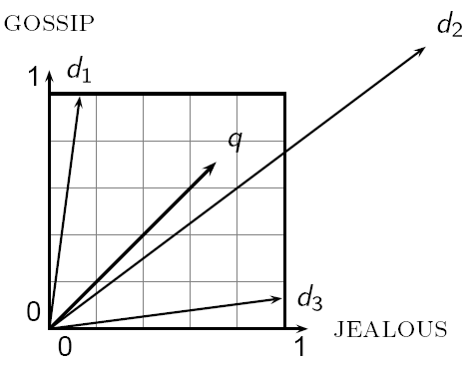
Why distance is a bad idea
The Euclidean distance between q and d₂ is large even though the distribution of terms in the query q and the distribution of terms in the document d₂ are very similar.

Slide 158
Use angle instead of distance
Thought experiment: take a document d and append it to itself. Call this document d′.
“Semantically” d and d′ have the same content
The Euclidean distance between the two documents can be quite large
The angle between the two documents is 0, corresponding to maximal similarity.
Key idea: Rank documents according to angle with query.
C. D. Manning, P. Raghavan and H. Schütze, Introduction to Information Retrieval

Slide 159
From angles to cosines
Sec. 63
The following two notions are equivalent.
Rank documents in decreasing order of the angle between query and document
Rank documents in increasing order of cosine(query,document)
Cosine is a monotonically decreasing function for the interval [0º, 180º]
C. D. Manning, P. Raghavan and H. Schütze, Introduction to Information Retrieval

Slide 160
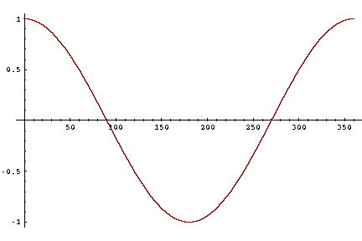
From angles to cosines
But how – and why – should we be computing cosines?
C. D. Manning, P. Raghavan and H. Schütze, Introduction to Information Retrieval

Slide 161
Length normalization
A vector can be (length-) normalized by dividing each of its components by its length – for this we use the L₂ norm:
Dividing a vector by its L₂ norm makes it a unit (length) vector (on surface of unit hypersphere)
Effect on the two documents d and d′ (d appended to itself) from earlier slide: they have identical vectors after length-normalization.
Long and short documents now have comparable weights
C. D. Manning, P. Raghavan and H. Schütze, Introduction to Information Retrieval

Slide 162
cosine(query,document)
Dot product
Unit vectors
q_{i} is the tf-idf weight of term i in the query
d_{i} is the tf-idf weight of term i in the document
cos(q,d) is the cosine similarity of q and d … or,
equivalently, the cosine of the angle between q and d.
C. D. Manning, P. Raghavan and H. Schütze, Introduction to Information Retrieval
Notes:
See Law of Cosines (Cosine Rule) wikipedia page

Slide 163
Cosine for length-normalized vectors
For length-normalized vectors, cosine similarity is simply the dot product (or scalar product):
for q, d length-normalized.
C. D. Manning, P. Raghavan and H. Schütze, Introduction to Information Retrieval

Slide 164
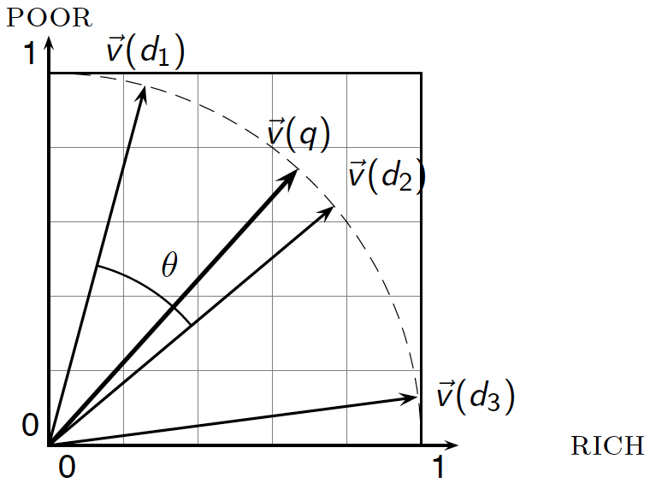
Cosine similarity illustrated
C. D. Manning, P. Raghavan and H. Schütze, Introduction to Information Retrieval

Slide 165
Cosine similarity amongst 3 documents
Sec. 6.3
term | SaS | PaP | WH
affection | 115 | 58 | 20
jealous | 10 | 7 | 11
gossip | 2 | 0 | 6
wuthering | 0 | 0 | 38
How similar are the novels
SaS: Sense and Sensibility
PaP: Pride and Prejudice
WH: Wuthering Heights
Term frequencies (counts)
Note: To simplify this example, we don't do idf weighting.
We use only tf = 1 + Log(count)
C. D. Manning, P. Raghavan and H. Schütze, Introduction to Information Retrieval

Slide 166
3 documents example contd.
Sec. 6.3
Log frequency weighting
After length normalization
term | SaS | PaP | WH
affection | 3.06 | 2.76 | 2.30
jealous | 2.00 | 1.85 | 2.04
gossip | 1.30 | 0 | 1.78
wuthering | 0 | 0 | 2.58
term | SaS | PaP | WH
affection | 0.789 | 0.832 | 0.524
jealous | 0.515 | 0.555 | 0.465
gossip | 0.335 | 0 | 0.405
wuthering | 0 | 0 | 0.588
cos(SaS,PaP) ≈ 0.789 × 0.832 + 0.515 × 0.555 + 0.335 × 0.0 + 0.0 × 0.0 ≈ 0.94
cos(SaS,WH) ≈ … ≈ 0.79
cos(PaP,WH) ≈ … ≈ 0.69
Why do we have cos(SaS,PaP) > cos(SaS,WH)?
C. D. Manning, P. Raghavan and H. Schütze, Introduction to Information Retrieval

Slide 167
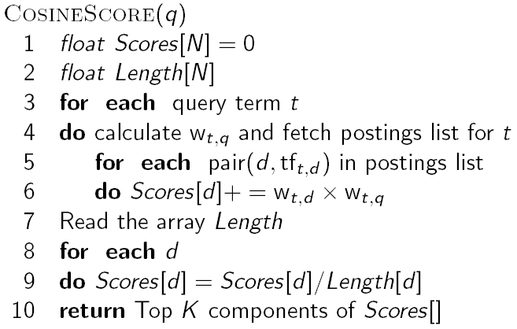
Computing cosine scores

Slide 168
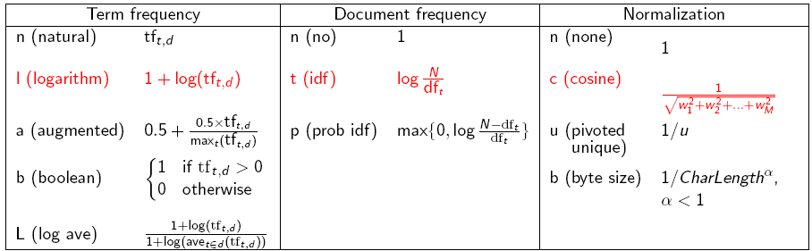
tf-idf weighting has many variants
Columns headed ‘n’ are acronyms for weight schemes.
Why is the base of the log in idf immaterial?
C. D. Manning, P. Raghavan and H. Schütze, Introduction to Information Retrieval
Notes:
n default is just term frequency
ltc is best known form of weighting

Slide 169
Weighting may differ in queries vs documents
Many search engines allow for different weightings for queries vs. documents
SMART Notation: denotes the combination in use in an engine, with the notation ddd.qqq, using the acronyms from the previous table
A very standard weighting scheme is: lnc.ltc
Document: logarithmic tf (l as first character), no idf and cosine normalization
Query: logarithmic tf (l in leftmost column), idf (t in second column), no normalization …
A bad idea?
C. D. Manning, P. Raghavan and H. Schütze, Introduction to Information Retrieval
Notes:
Leaving off idf weighting on documents is good for both efficiency and system effectiveness reasons.

Slide 170
tf-idf example: lnc.ltc
Document: car insurance auto insurance
Query: best car insurance
Term | Query |  |  |  |  |  | Document |  |  |  | Prod
 | tf-raw | tf-wt | df | idf | wt | n’lize | tf-raw | tf-wt | wt | n’lize
auto | 0 | 0 | 5000 | 2.3 | 0 | 0 | 1 | 1 | 1 | 0.52 | 0
best | 1 | 1 | 50000 | 1.3 | 1.3 | 0.34 | 0 | 0 | 0 | 0 | 0
car | 1 | 1 | 10000 | 2.0 | 2.0 | 0.52 | 1 | 1 | 1 | 0.52 | 0.27
insurance | 1 | 1 | 1000 | 3.0 | 3.0 | 0.78 | 2 | 1.3 | 1.3 | 0.68 | 0.53
Exercise: what is N, the number of docs?
Doc length =
Score = 0+0+0.27+0.53 = 0.8
C. D. Manning, P. Raghavan and H. Schütze, Introduction to Information Retrieval

Slide 171
Summary – vector space ranking
Represent the query as a weighted tf-idf vector
Represent each document as a weighted tf-idf vector
Compute the cosine similarity score for the query vector and each document vector
Rank documents with respect to the query by score
Return the top-K (e.g., K = 10) to the user
C. D. Manning, P. Raghavan and H. Schütze, Introduction to Information Retrieval

Slide 172
Key concepts
Inverted index
Dictionary & Postings
Tokens and terms
Merge algorithm
N-grams
Jaccard Coefficient
Precision, Recall, F1-Measure
Tf-idf
Cosine similarity
NOTE: there are several hidden slides. They cover interesting concepts that, though interesting, are not relevant for the purposes of this course

Slide 173
Metrics

Slide 174
Measuring relevance
Three elements:
A benchmark document collection
A benchmark suite of queries
An assessment of either Relevant or Nonrelevant for each query and each document

Slide 175
So you want to measure the quality of a new search algorithm?
Benchmark documents
Benchmark query suite
Judgments of document relevance for each query
5 million docs
Relevance
judgment
50000
sample
queries

Slide 176
Relevance judgments
Binary (relevant vs. non-relevant) in the simplest case
More nuanced relevance levels also used (0, 1, 2, 3 …)
What are some issues already?
5 million times 50K takes us into the range of a quarter trillion judgments
If each judgment took a human 2.5 seconds, we’d still need 10¹¹ seconds: nearly $300 million if you pay people $10 per hour to assess

Slide 177
Crowd source relevance judgments?
Present query-document pairs to low-cost labor on online crowd-sourcing platforms
Hope that this is cheaper than hiring qualified assessors
Lots of literature on using crowd-sourcing for such tasks
You get fairly good signal, but the variance in the resulting judgments is quite high

Slide 178
What else?
Still need test queries
Must be germane to docs available
Must be representative of actual user needs
Random query terms from the documents are not a good idea
Sample from query logs if available
Classically (non-Web)
Low query rates – not enough query logs
Experts hand-craft “user needs”

Slide 179
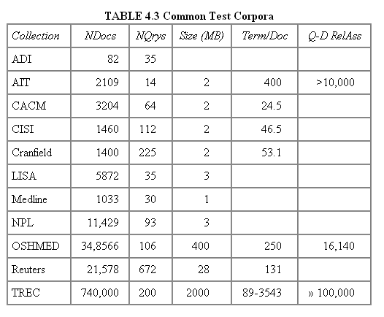
Early public test Collections (20th C)
Typical TREC
Recent datasets: 100s of million web pages (GOV, ClueWeb, …)

Slide 180
Now we have the basics of a benchmark
Let’s review some evaluation measures
Precision
Recall
DCG
…

Slide 181
Evaluating a Search System
Note: user need is translated into a query
Relevance is assessed relative to the user need, not the query
E.g., Information need: My swimming pool bottom is becoming black and needs to be cleaned.
Query: pool cleaner
Assess whether the doc addresses the underlying need, not whether it has these words

Slide 182
Unranked retrieval evaluation: Precision and Recall
Binary assessments
Precision: fraction of retrieved docs that are relevant P(relevant | retrieved)
Recall: fraction of relevant docs that are retrieved P(retrieved | relevant)
Precision P = tp/(tp + fp)
Recall R = tp/(tp + fn)
 | Relevant | Non-relevant
Retrieved | tp | fp
Not Retrieved | fn | tn

Slide 183
Rank-Based Measures
Binary relevance
Precision@K (P@K)
Mean Average Precision (MAP)
Mean Reciprocal Rank (MRR)
Multiple levels of relevance
Normalized Discounted Cumulative Gain (NDCG)

Slide 184

Precision@K
Set a rank threshold K
Compute % relevant in top K
Ignores documents ranked lower than K
Ex:
Prec@3 of 2/3
Prec@4 of 2/4
Prec@5 of 3/5
In similar fashion we have Recall@K

Slide 185
A precision-recall curve
Sec. 8.4

Slide 186

Mean Average Precision (MAP)
Consider rank position of each relevant doc
K₁, K₂, … K_{R}
Compute Precision@K for each K₁, K₂, … K_{R}
Average precision = average of P@K
Ex: has AvgPrec of
MAP is Average Precision across multiple queries/rankings

Slide 187
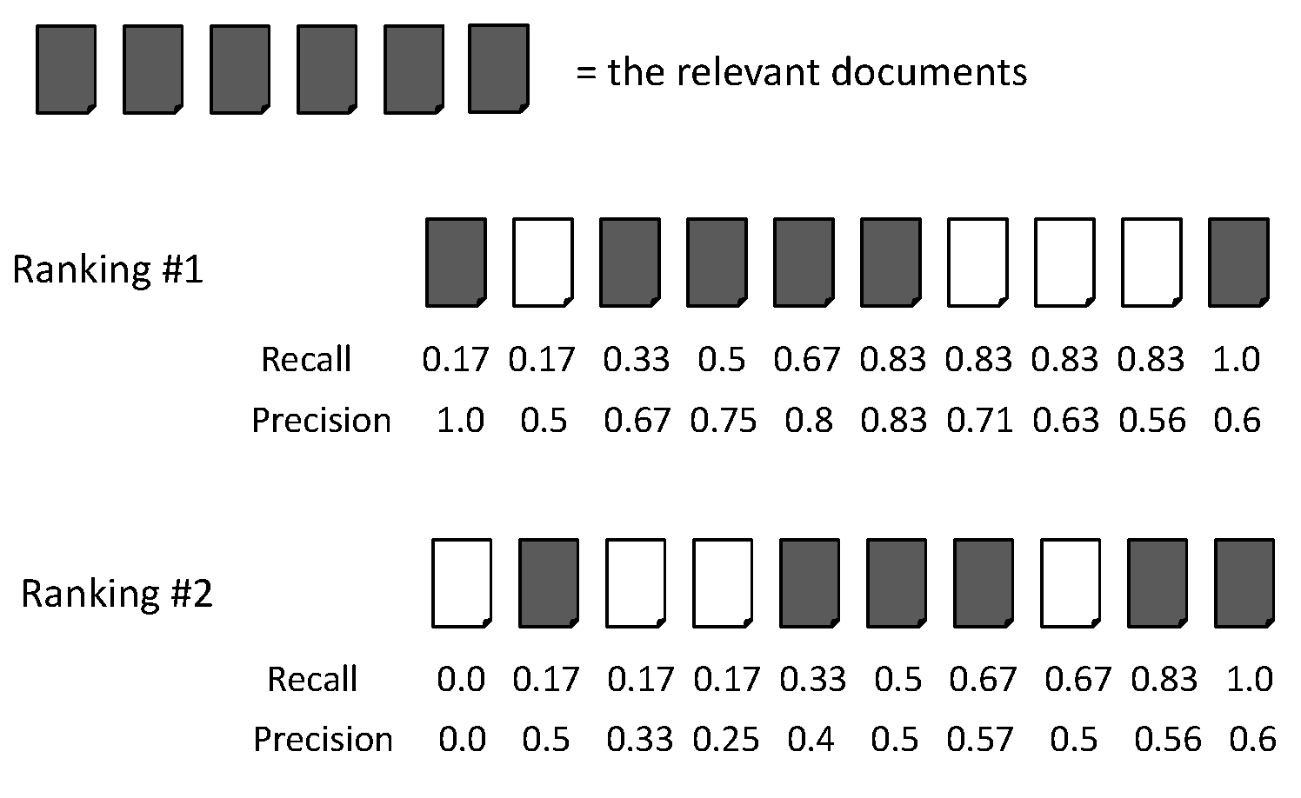
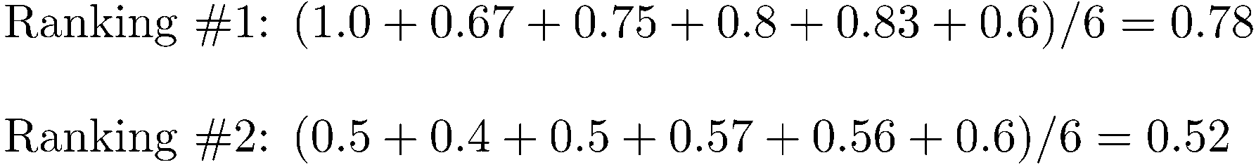
Average Precision

Slide 188
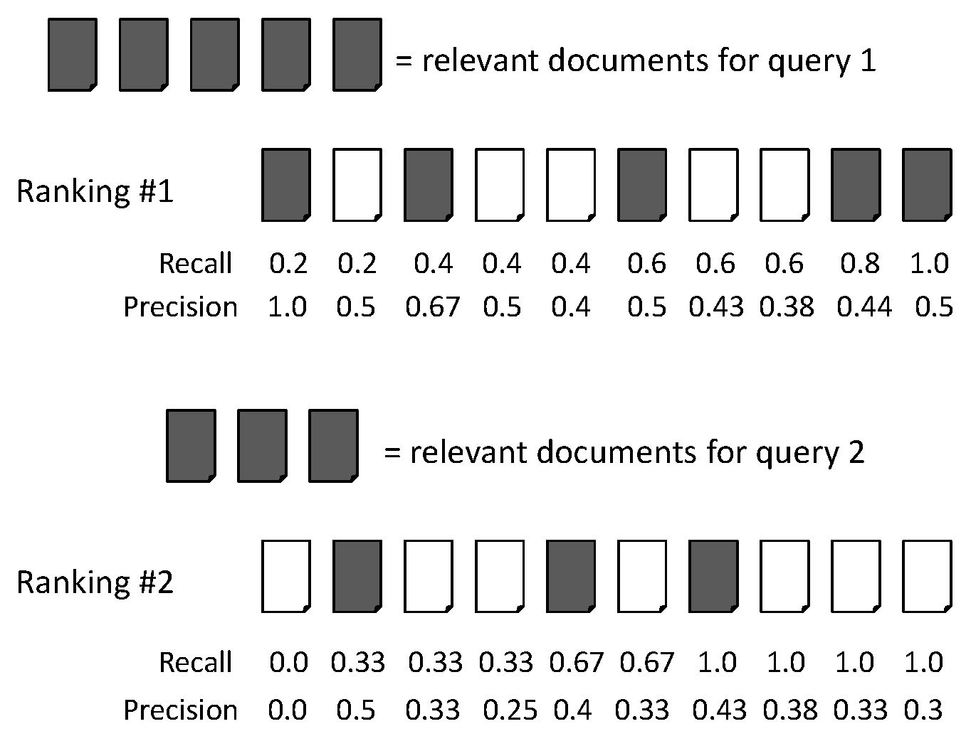
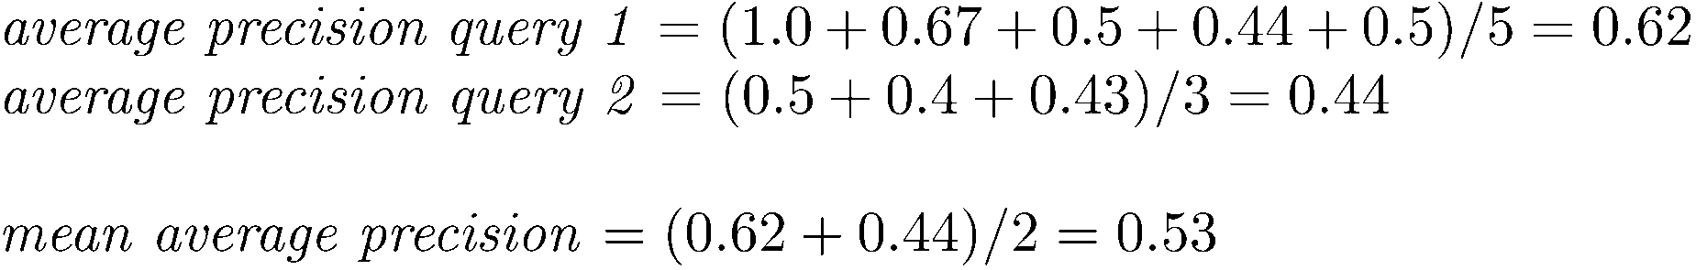
MAP

Slide 189
Mean average precision
If a relevant document never gets retrieved, we assume the precision corresponding to that relevant doc to be zero
MAP is macro-averaging: each query counts equally
Now perhaps most commonly used measure in research papers
Good for web search?
MAP assumes user is interested in finding many relevant documents for each query
MAP requires many relevance judgments in text collection

Slide 190
Examples
https://datasetsearch.research.google.com/

Slide 191
Resources
Christopher D. Manning, Prabhakar Raghavan and Hinrich Schütze, Introduction to Information Retrieval, Cambridge University Press. 2008. Cap.1, 2, 3, 4
http://www.miislita.com/information-retrieval-tutorial/cosine-similarity-tutorial.html
C. D. Manning, P. Raghavan and H. Schütze, Introduction to Information Retrieval

